Slide 1

TAP “Big 6” Indicators
Notes:
Total estimated time: 2 hours

Slide 2
Objectives
By the end of the session participants will:
Know the TAP “Big 6” indicators used to measure teacher candidates’ instructional growth
Understand how to use the “Big 6” indicators (TAP rubric) to both guide and identify instructional best practices
Be able to collect evidence from an observed lesson and use the TAP rubric to categorize that evidence

Slide 3

Agenda
TAP – The “big picture”
The “Big 6” indicators
Identify “effective teaching”
Unpack the “Big 6”
Discuss evidence and evidence collecting tools
Practice scripting and categorizing

Slide 4
Check Your TAP Knowledge
What are the two main goals of TAP?
TAP stands for…
TAP is a...
The “Big 6” indicators are...
The TAP rubric measures classroom instruction on a scale of ___ to ___, but the goal for TCs is to score a ___.

Slide 5

The Big Picture
The two main goals of TAP are:
Teacher Quality
Student Achievement

Slide 6
What is TAP?
The System for Teacher and Student Advancement (TAP)
TAP has been utilized in thousands of school districts across the nation as a method of investing in teacher leadership, rigorous evaluation, coaching, and aligned professional development.
TAP supports the instructional leadership work of principals and provides teachers with opportunities for professional growth, time to collaborate during the school day, fair and rigorous classroom evaluations to improve teaching, and school- based professional development to analyze student needs and identify strategies for student learning.
The TAP System is a comprehensive educator effectiveness model dedicated to attracting, developing, motivating, and retaining highly effective educators in order to raise achievement for all students.

Slide 7
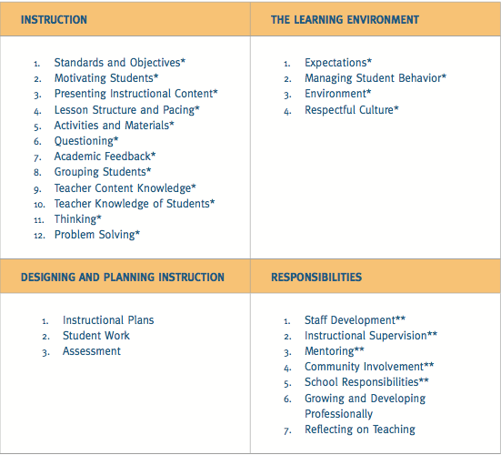
TAP Rubric
4 Domains, each contains performance indicators
Notes:
Chart from: TAP Leadership Handbook, 2006

Slide 8




What are the “Big 6”
4 of 12
1 of 4
1 of 3
Addressed in Professionalism Rubric
Notes:
Chart from: TAP Leadership Handbook, 2006

Slide 9
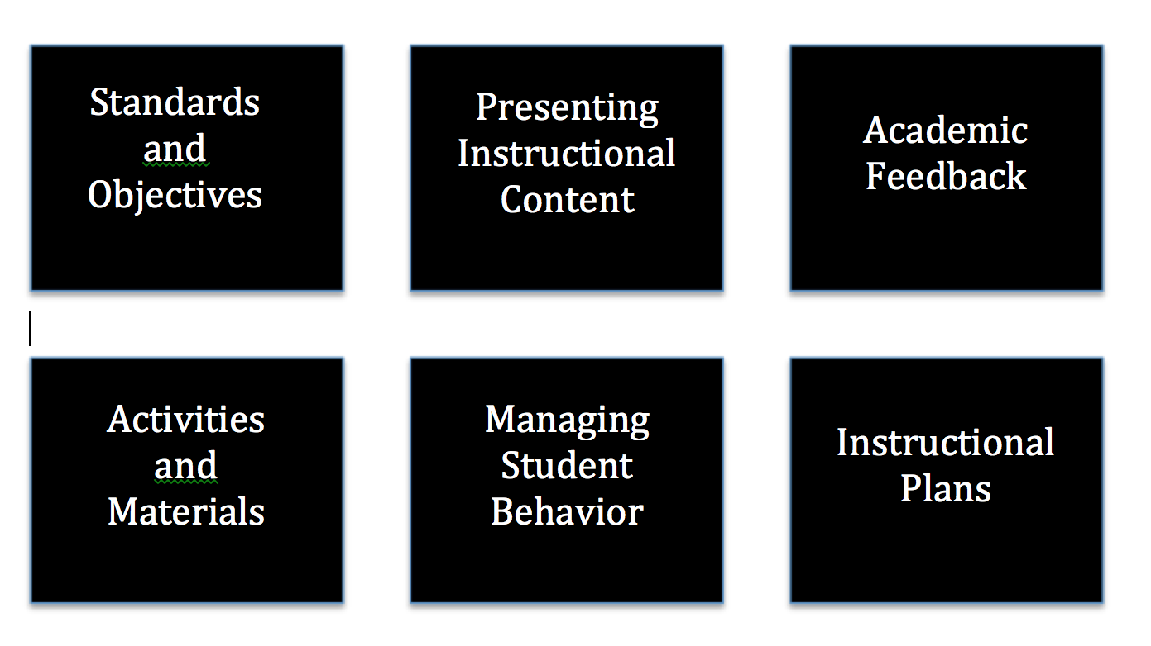
“Big 6” Indicators
TAP Big 6 Rubric Link

Slide 10

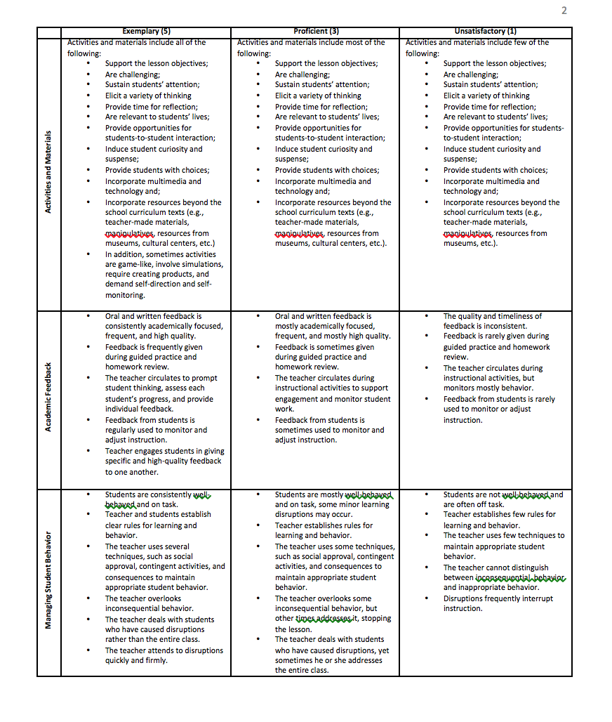


Navigating the Rubric
Performance Levels
Indicators
Descriptors
Indicators
Indicators

Slide 11

What is expected?
Performance Goal!

Slide 12

Name that Indicator
Link

Slide 13
Objectives
By the end of the session participants will:
Know the TAP “Big 6” indicators used to measure teacher candidates’ instructional growth
Understand how to use the “Big 6” indicators (TAP rubric) to both guide and identify instructional best practices
Be able to collect evidence from an observed lesson and use the TAP rubric to categorize that evidence

Slide 14
Characteristics of an
Effective Lesson
Think - Pair - Share
1 - On a post it, individually list the things (best practices, instructional strategies, etc.) you would expect to see in an effective lesson (1-2 minutes; one characteristic per post it).
2 – With your partner, share your ideas and come to an agreed upon list of things that you would expect to see (3 minutes).
3 - Select 3 characteristics to share with the whole group. No repeats!

Slide 15
Digging Deeper
Number off 1-5
→ 1 = IP 2 = MSB 3 = PIC 4 = AM 5 = AF
Read the descriptors in the proficient column
Highlight the key words or phrases in your assigned indicator
→ What impact does this indicator have on the
effectiveness of a lesson?
Create a simile and nonlinguistic representation for your indicator.
→ ____ is like ____ because...
Let’s do Standards & Objectives together!

Slide 16
Rubric Reflections
What connections can be made between the indicators?
SC: How might teacher candidates use the rubric as a reflection tool to evaluate their own practice?

Slide 17
Objectives
By the end of the session participants will:
Know the TAP “Big 6” indicators used to measure teacher candidates’ instructional growth
Understand how to use the “Big 6” indicators (TAP rubric) to both guide and identify instructional best practices
Be able to collect evidence from an observed lesson and use the TAP rubric to categorize that evidence

Slide 18
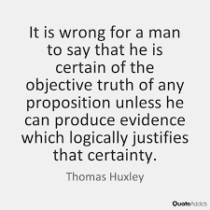
What is Evidence?
The collection of detailed evidence is ESSENTIAL for the evaluation process to be implemented accurately, fairly and for the intended purpose of the process.

Slide 19



Evidence Collecting Tools
PA Scripting and Scoring Template (*with cues at the descriptor level): Here
PA Scripting and Scoring Template (*with proficient descriptors at the indicator level): Here

Slide 20

Collecting Evidence
Evidence is...
  Specific and unbiased notes of what occurs during a classroom lesson:
    Scripting what the TC says
    Scripting what the TC does
    Scripting what the students say
    Scripting what the students do
    Copying wording from visuals used during the lesson
    Recording time segments of lesson

Slide 21
Evidence Collecting Tips
Collecting evidence requires detailed scripting.
1. Time stamps
2. Abbreviate (when needed)
3. Verbatim (as often as possible)
4. Paraphrase
5. Listen intentionally for questions and responses
6. Circulate
7.

Slide 22
Specific and Unbiased Evidence
T – “I like the way you used congruent.”
T – “She noticed that all quadrilaterals have four sides.”
T – “Very good giving me the exact description of a right angle.”
T – “I like the way you used math terms when you did that.”
T - encourages students to tell each other if their
responses are correct and why or why not
Students talk during partner activity... S1 - “I think the answer is 24.” S2 - “How did you get that answer?”
Evidence vs. Language from the rubric
Ask yourself…”Is my evidence what I heard the teacher and students say and do, or is it language from the rubric?”
T - communicated the objectives
T - circulated around the room and gave feedback
T - used visuals to establish the purpose of the lesson
S - were challenged by the activities
S - had choices during the lesson

Slide 23

Observing Classroom Instruction
We will view a short minute video of a lesson
Script what the teacher and students say and do
After viewing the lesson, we will collaboratively categorize our evidence
Groups will be assigned to focus on different indicators
Video Link
https://www.teachingchannel.org/videos/3rd-grade-ela-lesson
Notes:
At 5 minutes - Stop the video and share evidence collected thus far? Does your evidence sound like mine? (model)
At 10 minutes - Stop the video and have teacher candidates discuss their evidence in pairs

Slide 24
Collecting Evidence
6.
Are you capturing what the teacher and students are
saying and doing?

Slide 25
Categorize Your Evidence
6.
Review the evidence that you have collected
Use the rubric to categorize each piece of evidence
Remember the “rubric connections”...some evidence will fall under more than one indicator
The rubric is not a checklist...ask yourself, “Do I have evidence to support each descriptor?”
Let’s do Standards & Objectives together!

Slide 26
Example Evidence - S & O

Slide 27

Categorize Your Evidence
Remember:
Review the evidence that you’ve collected
Use the rubric to categorize each piece of evidence
Remember the “rubric connections”...some evidence will fall under more than one indicator
The rubric is not a checklist...ask yourself, “Do I have evidence to support each descriptor?”
Work in trios or quads to categorize your evidence.
**The SC will assign each group an indicator. Do not assign IP.
Notes:
Gradual Release
I Do - SO
We Do - PIC, AM, AF
You Do (in pairs) - MOT, LSP, QU, GS, TCK, TKS, TH, PS

Slide 28
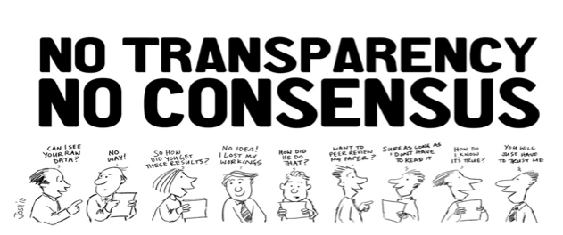
Inter-rater Reliability
The process by which a team comes to consensus on the collection of evidence and assignment of scores based upon the TAP rubric.
Let’s share our evidence!
Did we collect the same evidence for each indicator?

Slide 29
Check Your “Big 6” Knowledge
Work in pairs to identify each indicator.
1 - Instructional Plan
2 - Standards and Objectives
3 - Presenting Instructional Content
4 - Activities & Materials
5 - Academic Feedback
6 - Managing Student Behavior

Slide 30
Objectives
By the end of the session participants will:
Know the TAP “Big 6” indicators used to measure teacher candidates’ instructional growth
Understand how to use the “Big 6” indicators (TAP rubric) to both guide and identify instructional best practices
Be able to collect evidence from an observed lesson and use the TAP rubric to categorize that evidence

